Slide 1




Airbnb Exploration
615 Final from Xiang XU

Slide 2

Content
EDA
BENFORD
TEXT
MAP
Airbnb Exploration
Notes:
You can use this slide as your opening or closing slide. Should you choose to use it as a closing, make sure you review the main points of your presentation. One creative way to do that is by adding animations to the various graphics on a slide. This slide has 4 different graphics, and, when you view the slideshow, you will see that you can click to reveal the next graphic. Similarly, as you review the main topics in your presentation, you may want each point to show up when you are addressing that topic.
Add animation to images and graphics:
Select your image or graphic.
Click on the Animations tab.
Choose from the options. The animation for this slide is “Split”. The drop-down menu in the Animation section gives even more animations you can use.
If you have multiple graphics or images, you will see a number appear next to it that notes the order of the animations.
Note: You will want to choose the animations carefully. You do not want to make your audience dizzy from your presentation.

Slide 3
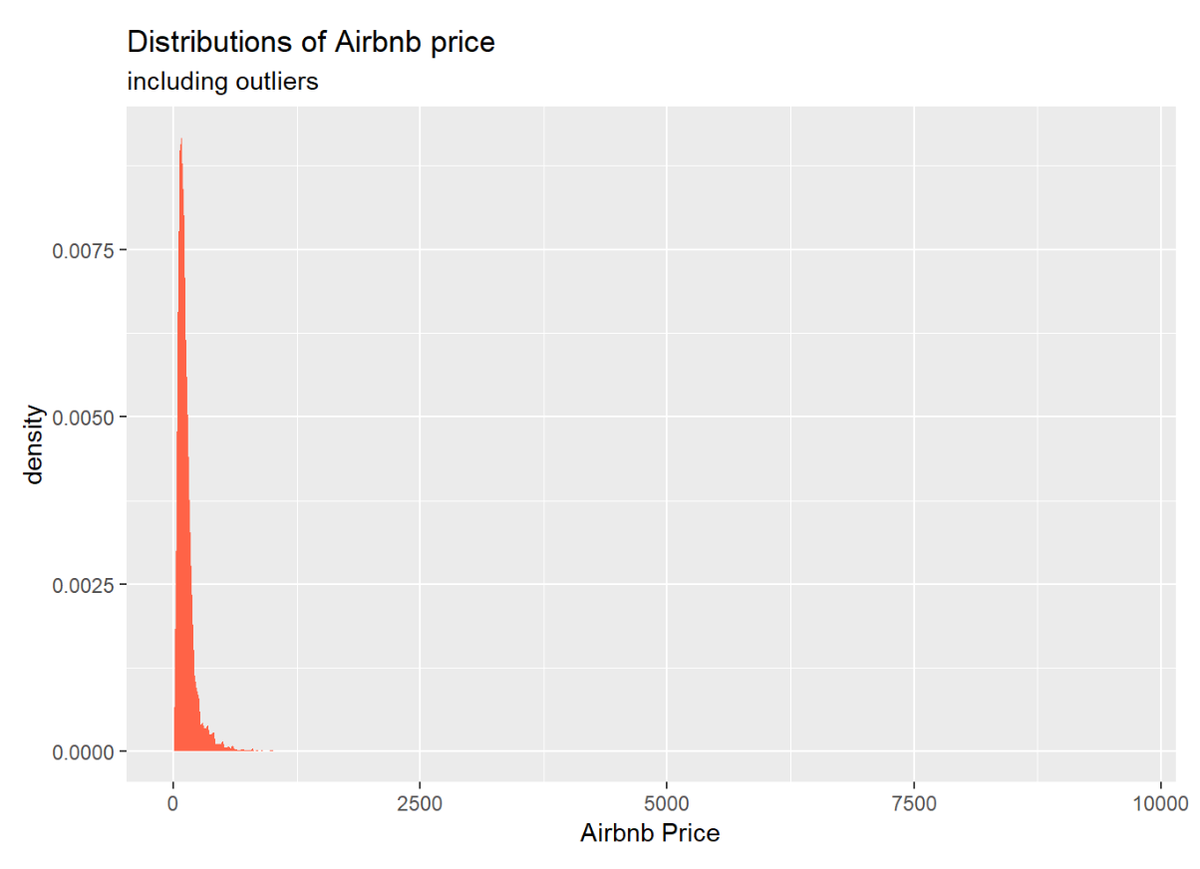
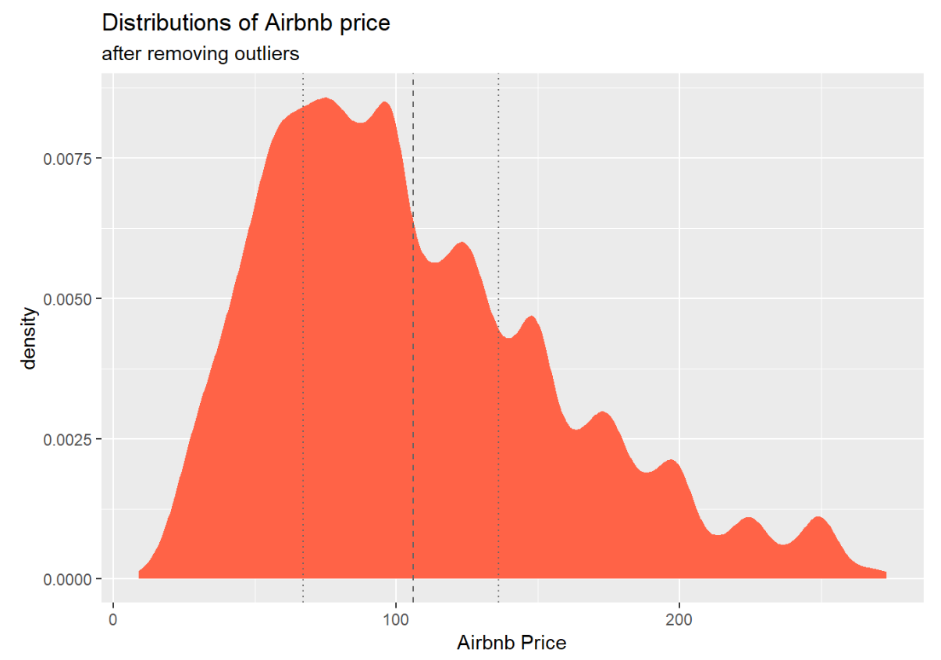
EDA : Price Distribution
With Raw Data
After deleting outliers

Slide 4
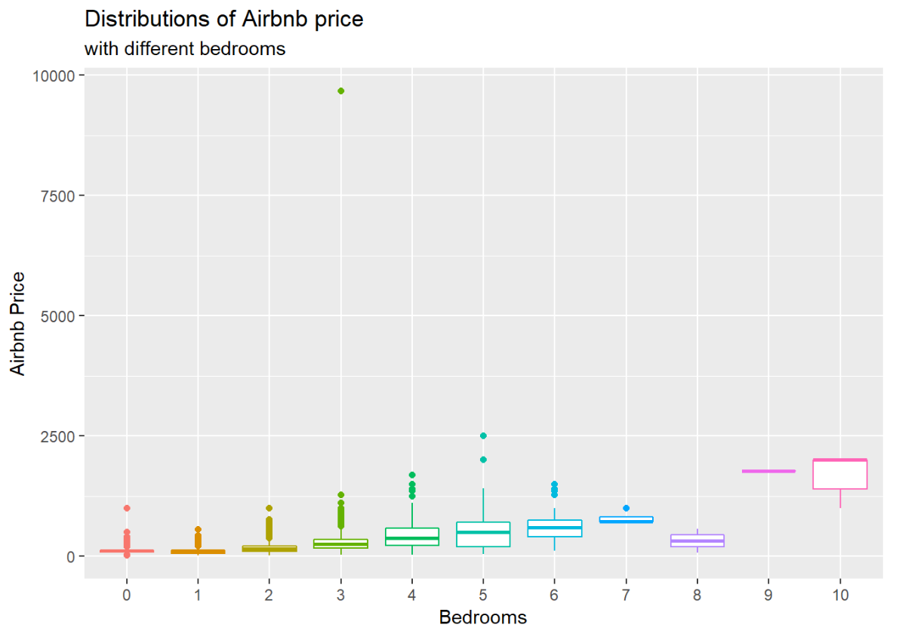
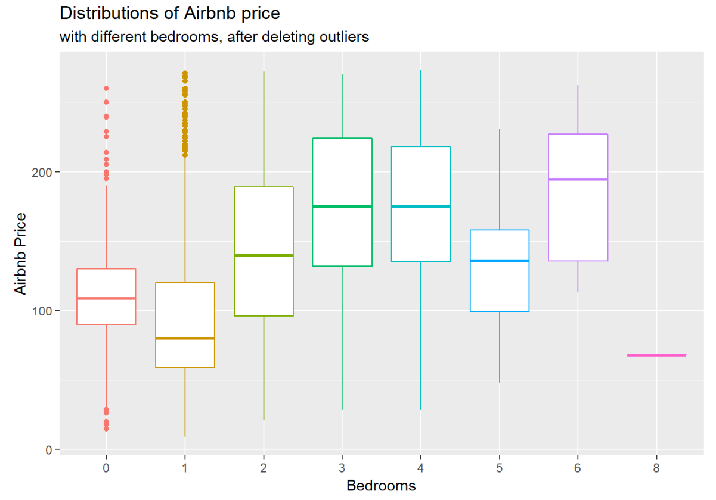
EDA : Price with different bedrooms
With Raw Data
After deleting outliers

Slide 5
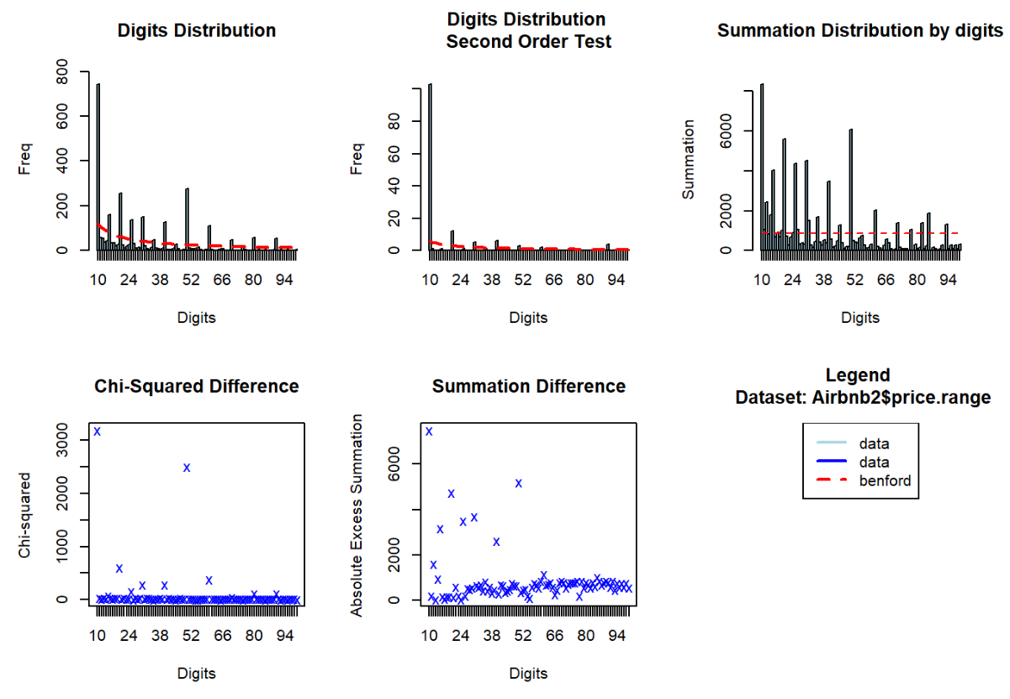
Benford Analysis
With Price

Slide 6
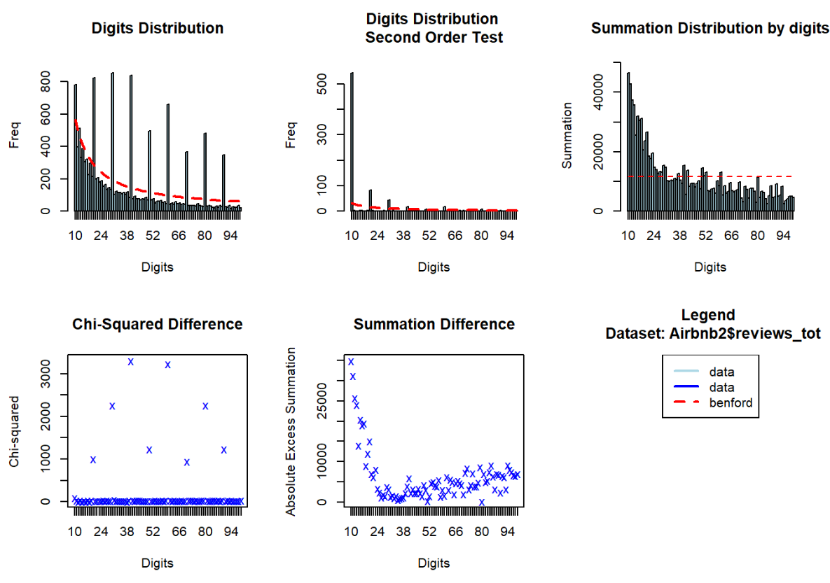
Benford Analysis
With Reviews

Slide 7
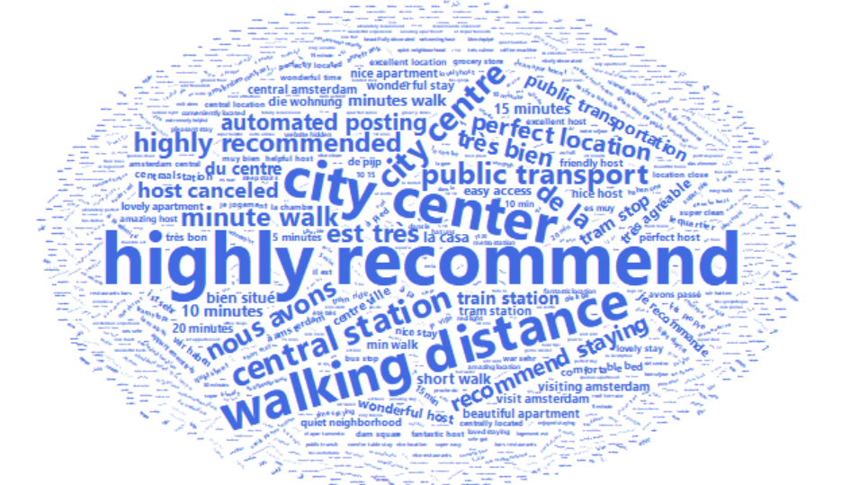
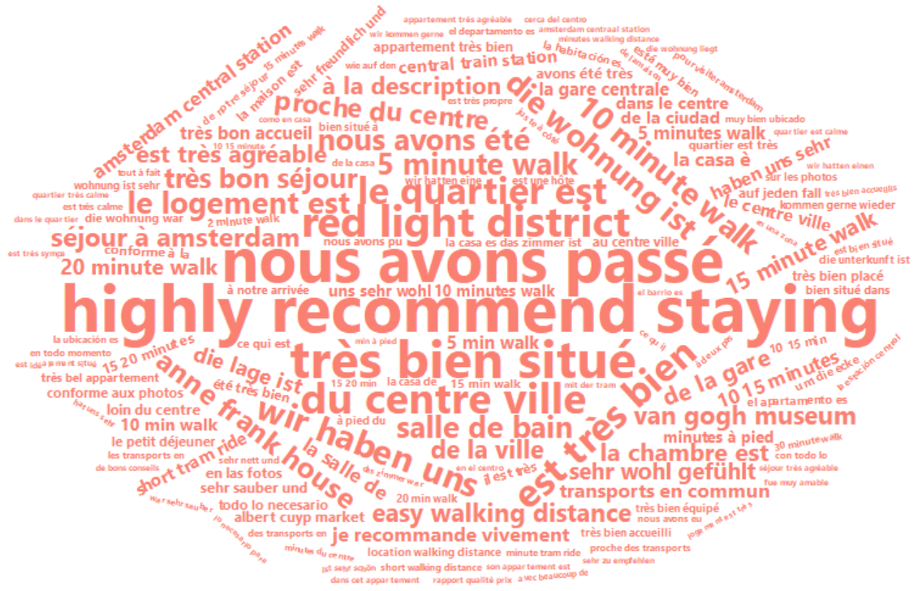
Text Mining
Bigram Word Frequency
Trigram Word Frequency

Slide 8
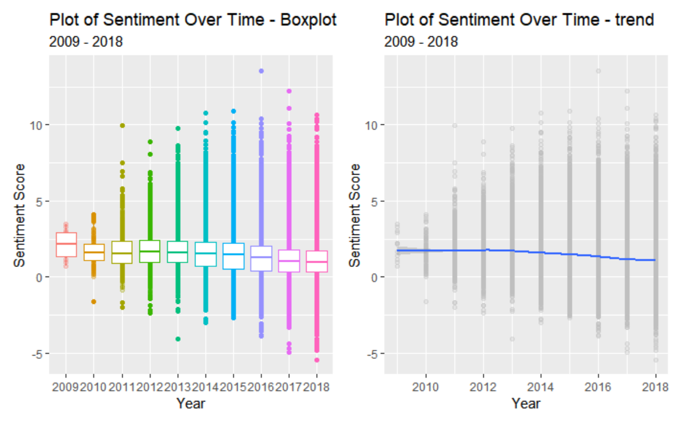
Sentiment score based on timeline

Slide 9
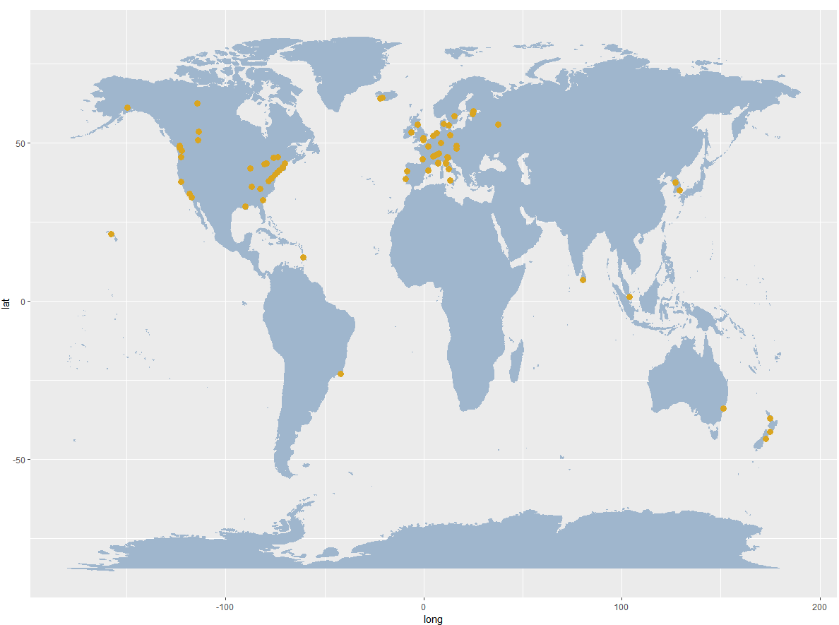
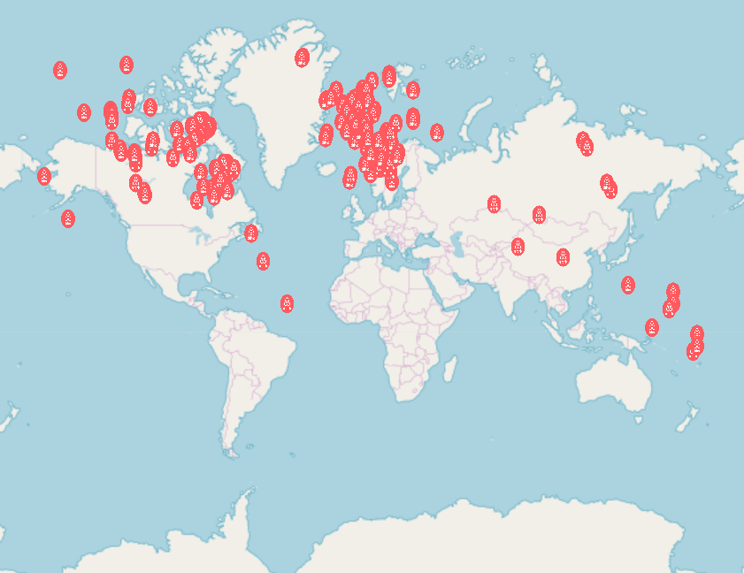
MAPs

Slide 10
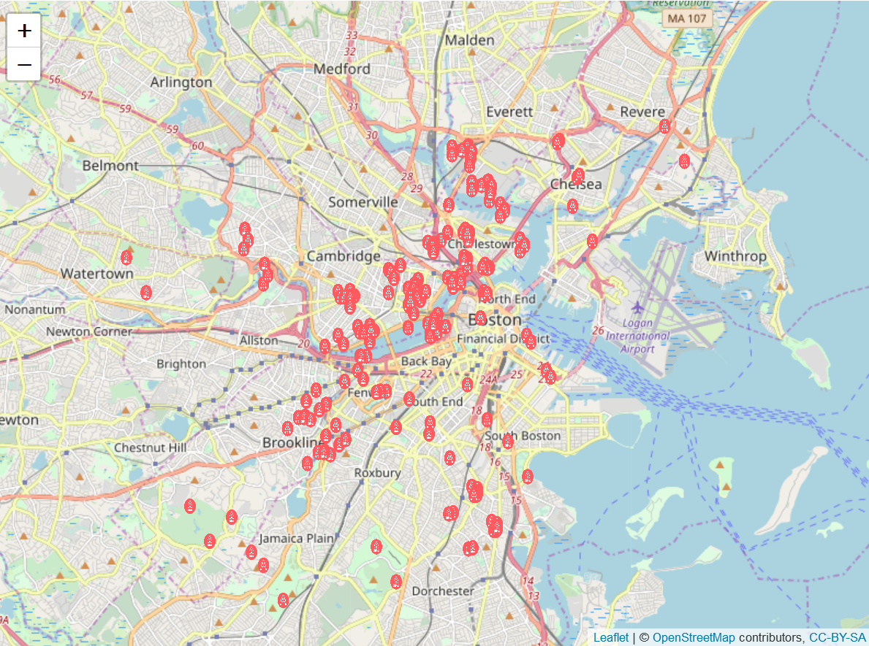
MAP Leaflet
What if we just focus on Boston?
Let’s sample 100 records from Boston data and see their location.
Note:
if use too many records(like 500) to draw, R will quit.

